Slide 1
Front End Engineering-I Project
Team Details:
Phalya (2210990649)
Payal Dhiman(2210990647)
Pearl(2210990648)
Parv Kapoor(2210990646)
Faculty Coordinator: Dr. Vikas Solanki
:
Chitkara University Institute of Engineering and Technology,
Chitkara University, Punjab

Slide 2
Table of Contents
Introduction
Problem Statement
Technical Details
Key Features
Project Highlights
Conclusion
References/Links used

Slide 3
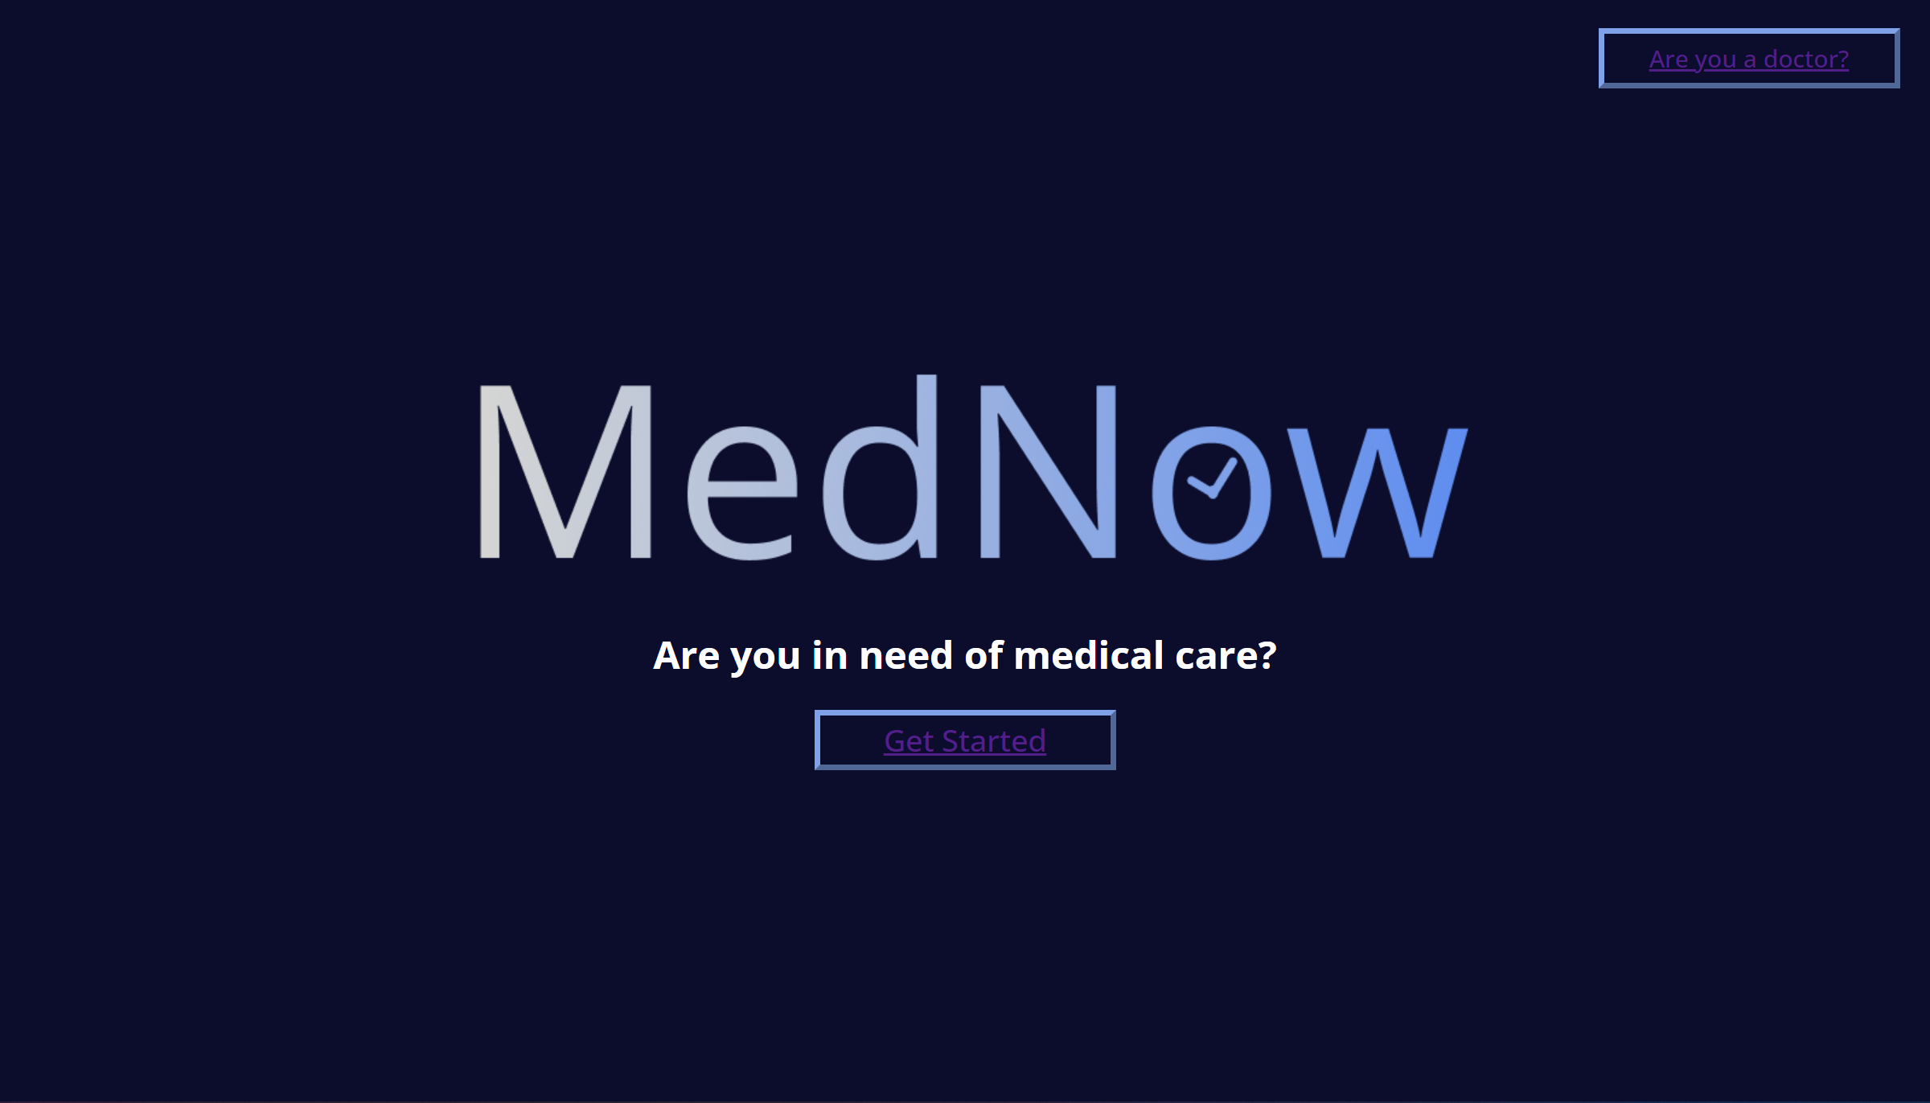

Slide 4
Introduction
The title of the project is “Login Authentication” and the team member’s names are:
1.Phalya (2210990649)
2.Payal Dhiman(2210990647)
3.Pearl (2210990648)
4.Parv Kapoor(2210990646)
The aim of Login authentication is the way of confirming the identity of a user while they access their profile on a particular platform.MedNow is a cutting-edge healthcare platform that connects patients with medical professionals online, providing convenient access to healthcare services. Purpose of Login Authentication Web Page: The login authentication web page serves as the gateway for users to access their MedNow accounts securely.
.

Slide 5
Introduction
Security: Protecting user data is a top priority. Login authentication ensures that only authorized users can access their accounts, safeguarding sensitive personal and medical information.
User Verification: Authentication verifies the identity of the user, preventing unauthorized access and maintaining the integrity of the platform.
User Experience: A well-designed authentication process provides a smooth and hassle-free experience for users, improving overall satisfaction and engagement.

Slide 6
Problem Statement
Inadequate Security Measures: The existing authentication system does not incorporate security measures to protect user accounts and sensitive medical information.This puts users at risk of unauthorized access,and compromises to their personal information.
Limited Authentication Options: The login process relies on username and password credentials, which are susceptible to brute-force attacks and account takeovers.
Complex Password Recovery: The current password recovery mechanism is time-consuming for users who have forgotten their passwords. It may involve manual intervention and lengthy verification processes, causing frustration and hindering user experience.
User Interface and Experience: The current login authentication web page lacks an intuitive and user-friendly design. The interface may be cluttered, confusing, or not optimized for various devices,

Slide 7
Problem Statement
leading to a subpar user experience and potentially discouraging users from engaging with the platform.

Slide 8
Technical Details
The project LOGIN AUTHENTICATION, has been
created using front end technologies and method .
Here is the brief overview of used ones:
HTML: HTML has been used to create the structure and content of the log in page including the login
form, links and other elements.
CSS: CSS has been used to style and layout the login page making it visually appealing and user friendly. This includes defining the colors, fonts, spacing and positioning of various elements.
Javascript:JavaScript is a scripting language that enables you to create dynamically updating content, control multimedia, animate images, and pretty much everything else.

Slide 9
Key Features
.
LOGIN page have following features for user friendly interaction:

Slide 10
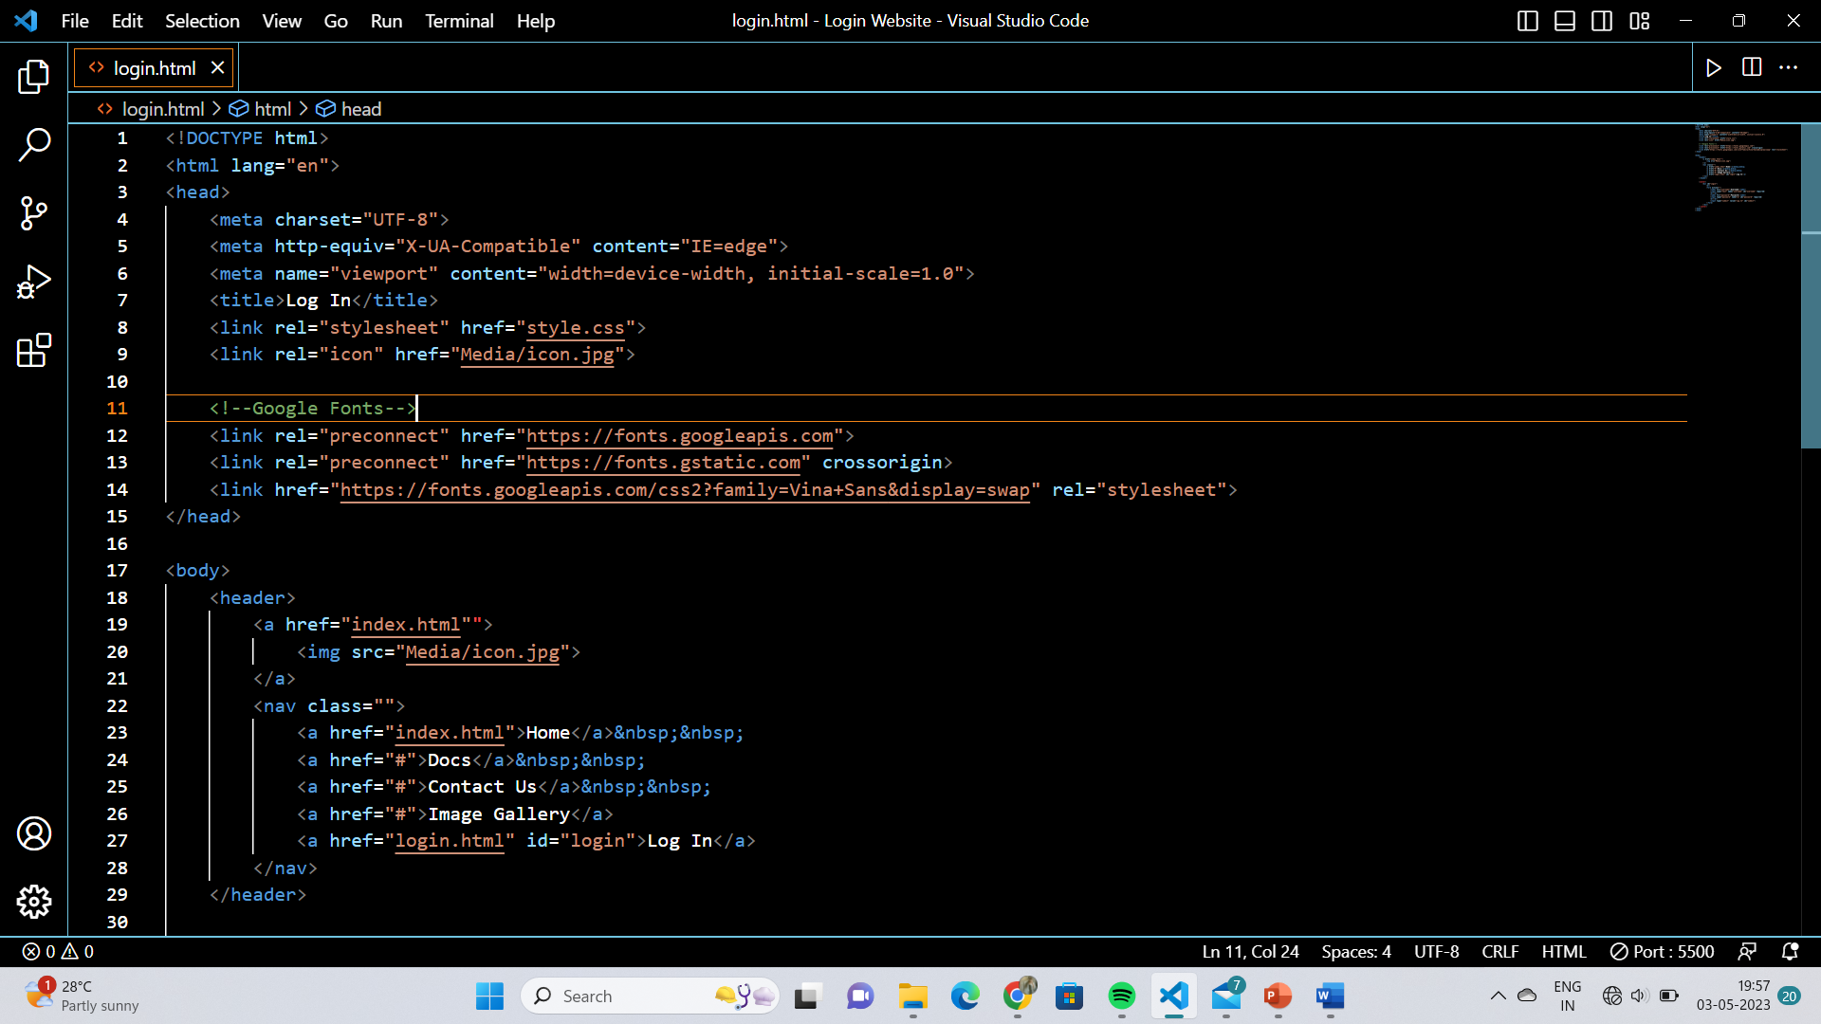
Project Highlights

Slide 11
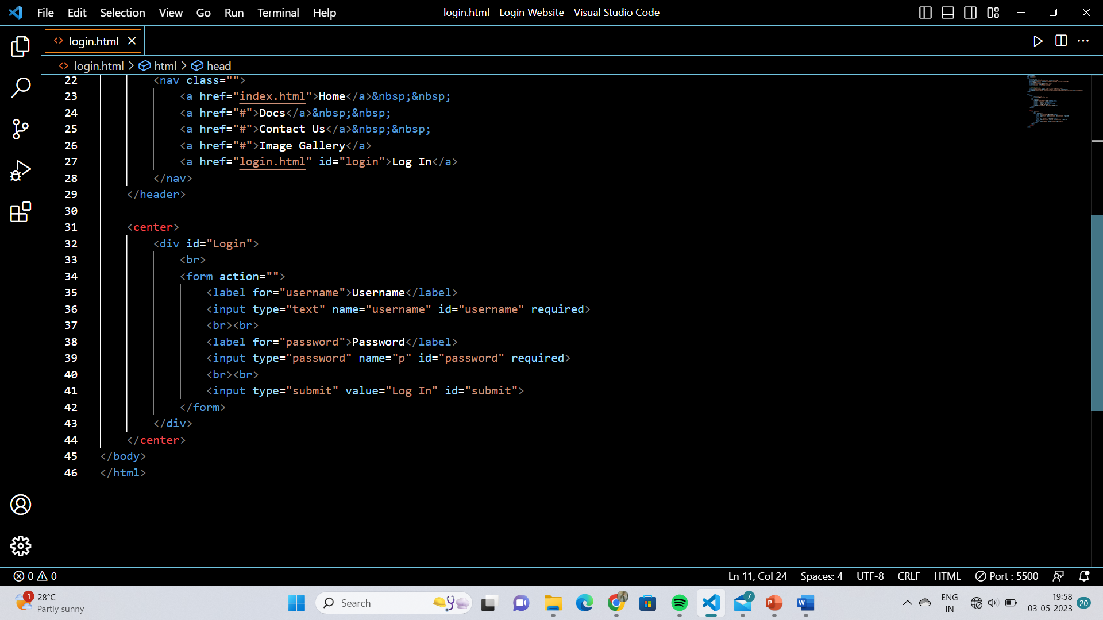
Project Highlights

Slide 12
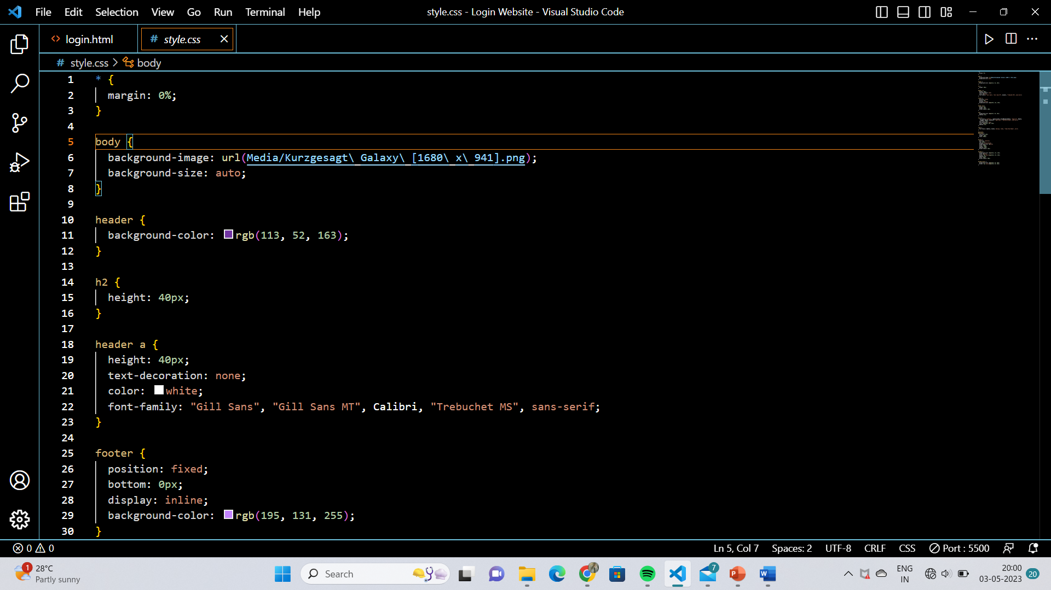
Project Highlights

Slide 13
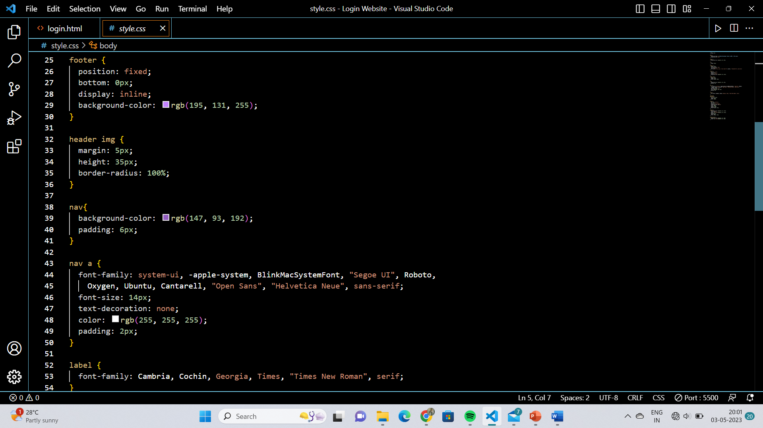
Project Highlights

Slide 14
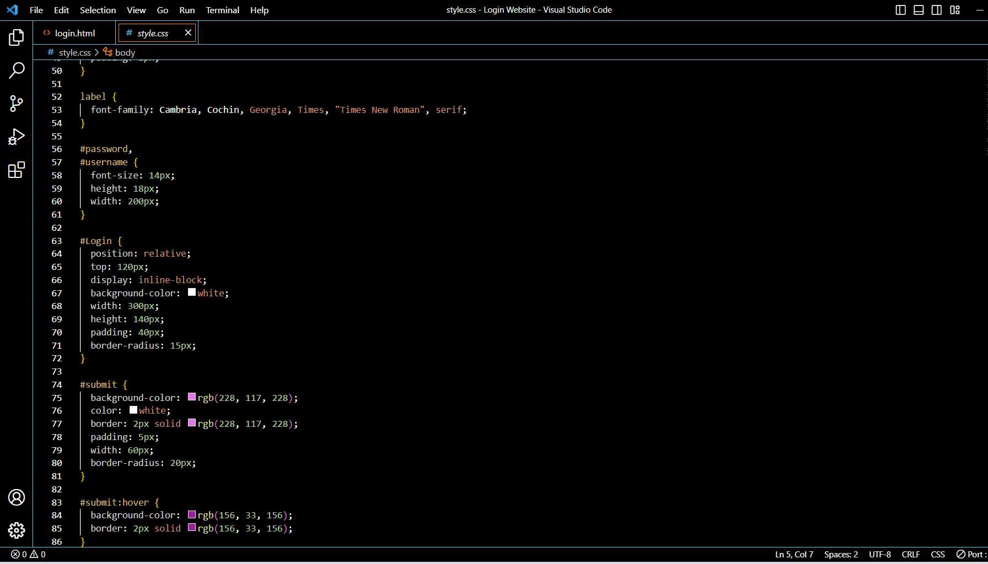
Project Highlights

Slide 15
Conclusion
In conclusion, the login authentication web page is a crucial component of MedNow's platform, ensuring the security and privacy of user accounts and data.
By implementing security measures, a user-friendly interface, and following best practices, MedNow can provide a secure login experience for its users.

Slide 16
References/Links used
https://community.articulate.com
https://www.w3schools.com

Slide 17


